Slide 1
Github Profile Viewer
Presented
by
Fahaam Khan (2210990309)
Keshav Dhiman (2210990503)
Nitish Mittal (2210990624)
Kheyanshu Garg (2210990508)
Under the supervision
of
Ms. Parul Gehlot
Mr. Vikas Patel
Chitkara University Institute of Engineering and Technology
Chitkara University, Punjab

Slide 2
Introduction
Problem Statement: Github scenario is to enter the username and the password of the user to get the user Github profile. Develop a project that allows users to easily view Github profile and repositories through a user friendly interface.
Solution: Our project fetches data from the Github API and displays a user friendly interface of the user Github profile and repositories. No need to enter the password again and again. Users can enter a Github username and our project will retrieve and present the user’s information, including user’s Github followers, following, basic information of user and the repositories. Our project saves the time of the user and help users to explore Github profiles efficiently and conveniently.

Slide 3
Motivation of Research
The motivation behind the research for this project stems from the desire to streamline access to GitHub profiles and repositories. GitHub serves as a hub for developers to collaborate, share code, and showcase their projects. However, navigating through profiles and repositories can sometimes be boring. By developing this project which fetches data from the GitHub API and present it in a user-friendly interface, we aim to simplify this process. This project seeks to empower users to easily explore GitHub, discover interesting projects, and connect with developers worldwide. Ultimately, our goal is to enhance the accessibility and usability of GitHub, fostering a more efficient and enjoyable experience for users to get their Github profile as in less time and in easy way.

Slide 4
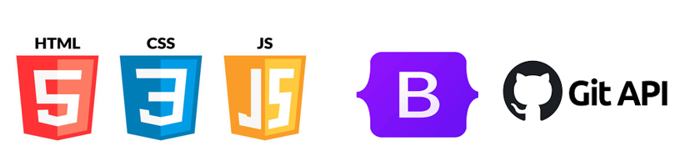
Tools & Technologies
HTML/CSS: For structuring and styling the webpage, ensuring a visually appealing and user-friendly interface.
JavaScript: Implemented for dynamic behavior and functionality, including fetching data from the GitHub API and updating content in real-time.
Bootstrap: Utilized for responsive design elements, ensuring compatibility across various devices and screen sizes.
GitHub API: Leveraged to fetch user profiles and repositories, providing up-to-date information to users.
AJAX (Asynchronous JavaScript and XML): Enabled asynchronous requests to the GitHub API, facilitating data retrieval and dynamic content updates without page reloads.

Slide 5
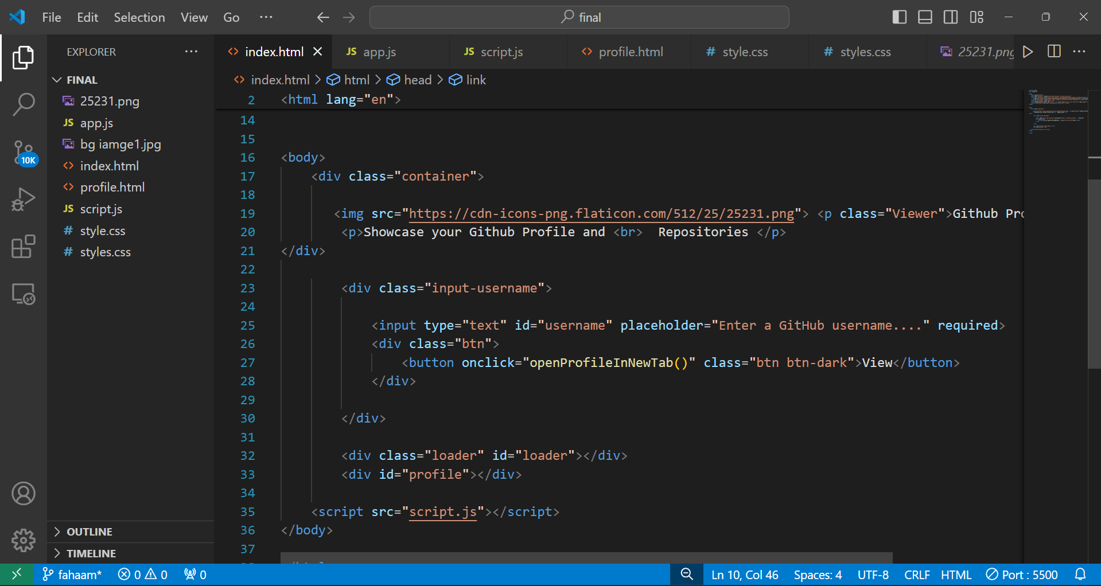
Code Snapshots
1. Html file of landing page

Slide 6
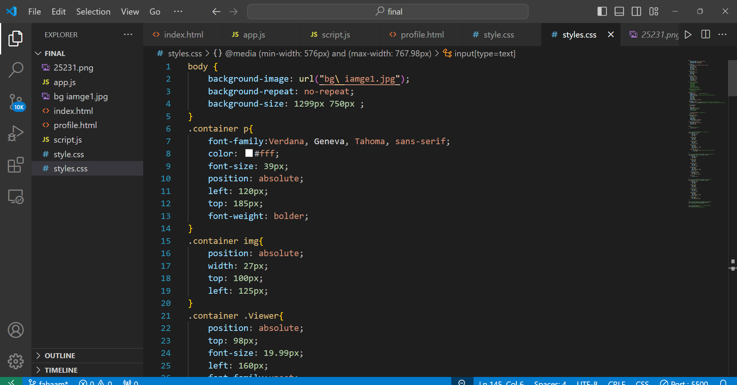
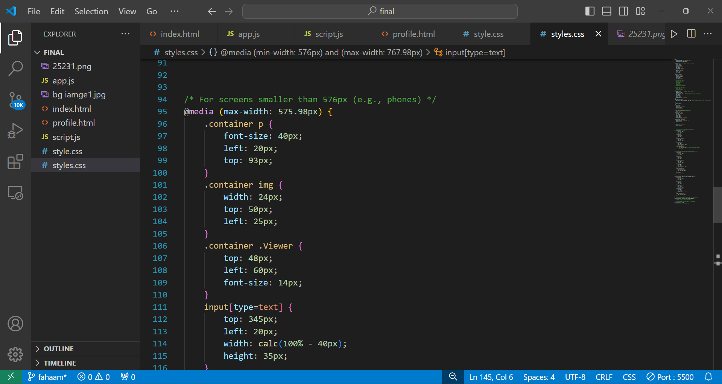
Conti….
2. CSS files of landing page

Slide 7
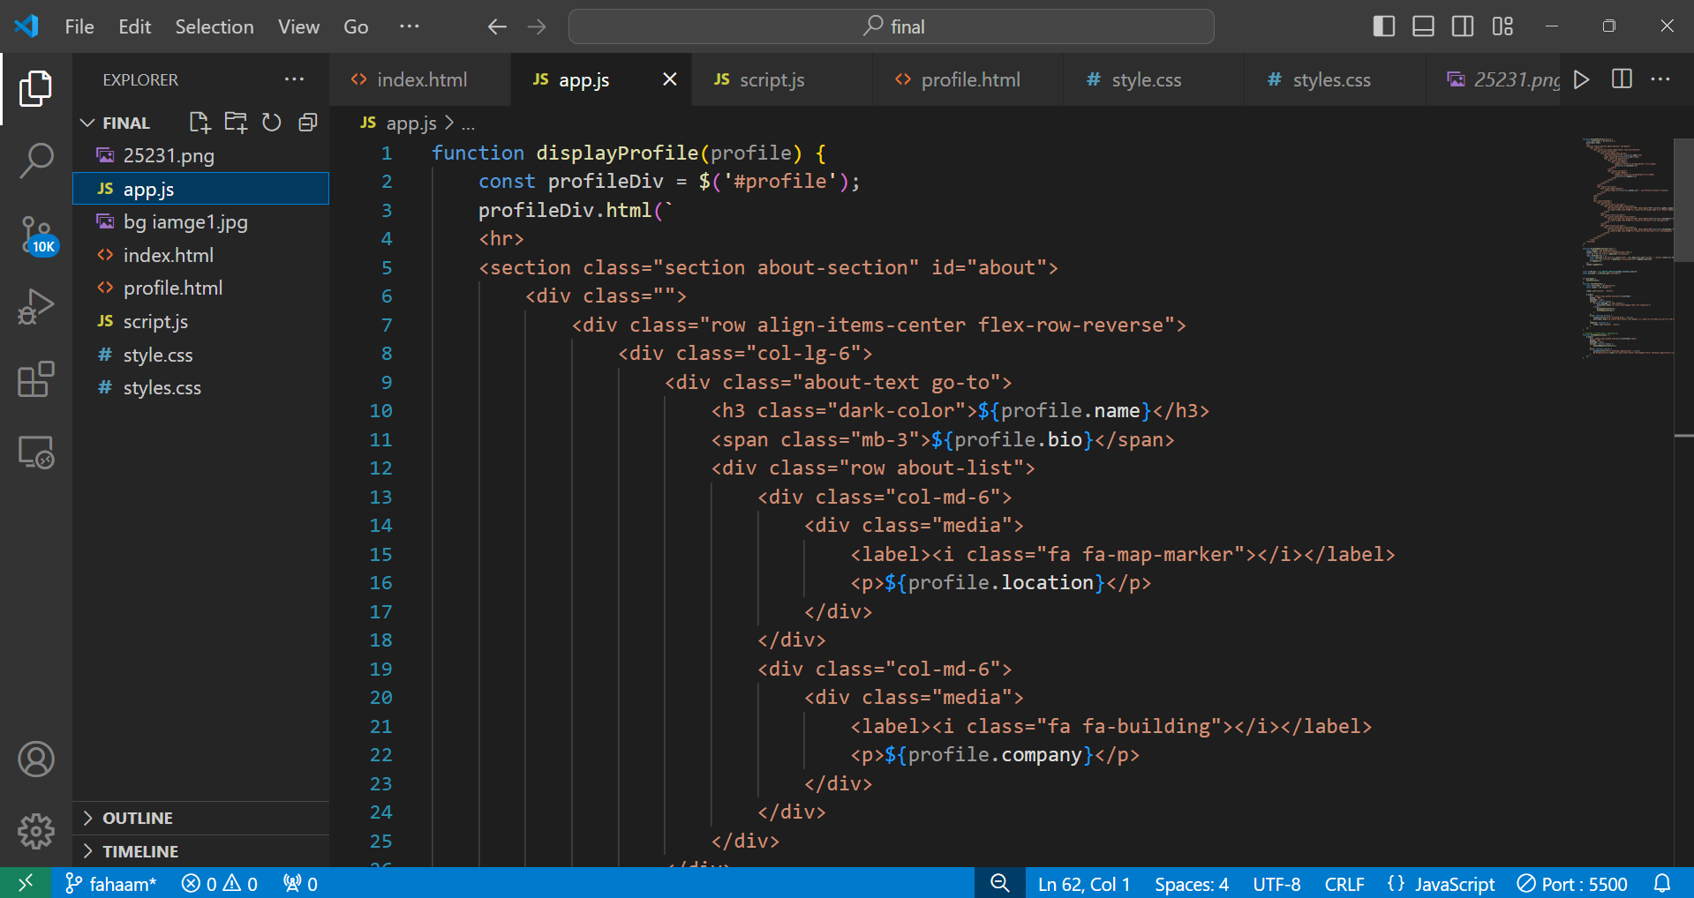
Conti...
3. Javascipt API fetch code

Slide 8
Conclusion/Theme Plan
Conclusion: In conclusion, the GitHub Profile Viewer project offers a user-friendly solution for exploring GitHub profiles and repositories. By leveraging the GitHub API, we've created a tool that simplifies the process of accessing and discovering projects and developers on the platform. Through our efforts, we've aimed to enhance the accessibility and usability of GitHub, empowering users to engage with the vast repository of code in a more efficient and enjoyable manner.
Theme: The theme plan for this project revolves around simplicity, accessibility, and usability. We prioritize creating a clean and intuitive interface that allows users to easily navigate and explore GitHub profiles and repositories. Our design choices focus on providing a seamless experience, ensuring that users can effortlessly find the information they need. Additionally, we emphasize responsiveness, ensuring that the application works seamlessly across different devices and screen sizes. Through our theme plan, we aim to deliver a user-centric solution that enhances the overall experience of interacting with GitHub.

Slide 9
References
GitHub API Documentation: Official documentation provided by GitHub for developers to understand how to interact with GitHub's API. GitHub API Documentation
jQuery Documentation: jQuery is used in the project for DOM manipulation and AJAX requests. The documentation provides guidance on using jQuery effectively. jQuery Documentation
Bootstrap Documentation: Bootstrap is utilized for styling and layout. The documentation offers insights into utilizing Bootstrap components and utilities. Bootstrap Documentation
Font Awesome Documentation: Font Awesome icons are used in the project for visual elements. The documentation helps in selecting and implementing icons. Font Awesome Documentation
MDN Web Docs: Mozilla Developer Network provides comprehensive documentation on HTML, CSS, and JavaScript, serving as a valuable resource for understanding these technologies. MDN Web Docs
Stack Overflow: An online community where developers ask questions and share knowledge. It can be useful for troubleshooting issues and finding solutions related to web development. Stack Overflow

Slide 10
Questions???
Any Questions
Feel Free to Ask…

Slide 11
Thanks...

